Slide 1
Machine Learning
Notes:
A look the field of machine learning. We have emphasized the importance of some form of feedback to the system.
With supervised learning the agent is provided with immediate feedback so that it knows at once if it has been correct.
With unsupervised learning no feedback is provided while training is ongoing; however, eventually the agent will know if it is performing well.

Slide 2
Business Understanding
Data Preparation
Modelling
Evaluation
Deployment
Data Understanding
The Process
CRISP-DM
Notes:
Cross Industry Standard Process for Data Mining (CRISP-DM)
Breaks everything down into 6 phases
Allows for going bac k a step – more agile approach to understanding
Business Understanding
An initial opportunity assessment
Identification of the business questions that are candidates for the solutions
Problem formulation
Cost-benefit analysis
Understanding Data
Identifying data types (string, integer, dates, boolean)
Determining the distribution (Discrete/Categorical or Continuous)
Population of values or identification missing values (dense or sparse)
Generating a statistical profile of the data (Min, Max, Mean, Counts, Distinct Count, etc)
Identifying correlation within the data set
Data science involves:
Finding data
Acquiring data
Cleaning and transforming data
Understanding relationships in data
Delivering value from data

Slide 3
What is Machine Learning?
Notes:
A specific branch of artificial intelligence
Programs that can teach themselves, change and grow over time
Often used for predicting states and answering questions – but not all machine learning is applicable to data science
Supervised/Unsupervised/Reinforcement learning styles
Machine learning takes tasks which people can do, given infinite patience and time and then speed this up.
Think of it as a machine having a task to achieve. To achieve this, it uses some information about past experiences. It can then predict for a new set of data what the outcome may be. If using something like supervised learning, this is then graded and can be used to improve the past experience.

Slide 4
Machine learning uses sophisticated algorithms to “learn” from massive volumes of Big Data. The more data the algorithms can access, the more they can learn.
Notes:
A specific branch of artificial intelligence
Programs that can teach themselves, change and grow over time
Often used for predicting states and answering questions – but not all machine learning is applicable to data science
Supervised/Unsupervised/Reinforcement learning styles
Machine learning takes tasks which peopl e can do, given infinite patience and time and then speed this up.
Think of it as a machine having a task to achieve. To achieve this, it uses some information about past experiences. It can then predict for a new set of data what the outcome may be. If using something like supervised learning, this is then graded and can be used to improve the past experience.

Slide 5

Types of Machine Learning
Notes:
https://medium.com/datadriveninvestor/ai-in-finance-cutting-through-the-hype-with-case-studies-f361518b00d4
https://towardsml.com/2018/02/17/machine-learning-an-overview-and-the-essential-algorithms/
Supervised learning
Generally perform well with new data
Require a labelled set of data
This can take a long time and be inaccurate
Unsupervised learning
No guidance provided ahead of time
Algorithms are self sufficient and can provide labels
Can find unexpected or unknown patterns in data
Harder to tell if it is correct or not
Reinforcement learning
No human involvement
Based on the idea of cost/reward function
Needs to balance exploring data with exploitation

Slide 6
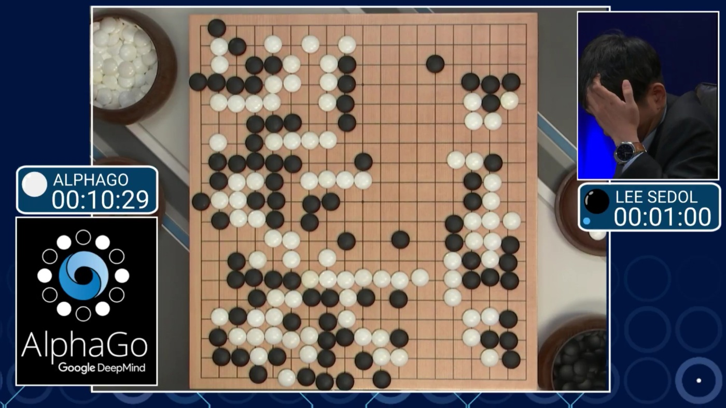

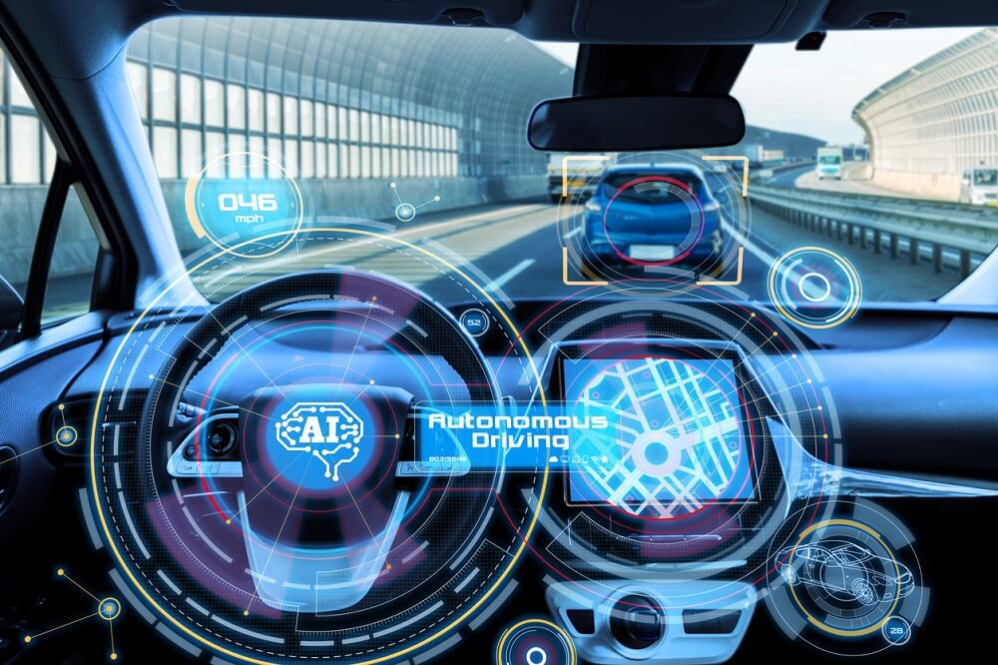
Types of Machine Learning
AlphaGo
Youtube recommendations
Autonomous Driving
Notes:
Def: apply statistical methods to improve performance based on previous experience or detect new patterns in massive amount of data.
Key words
Improve performance / detect new patterns
Previous experience / Massive amount of data

Slide 7
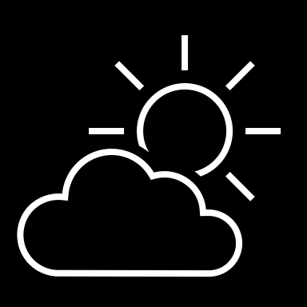
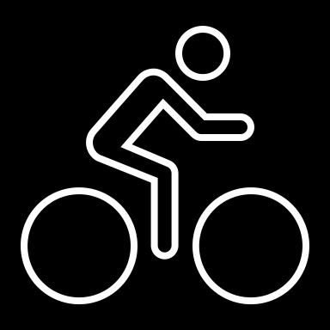
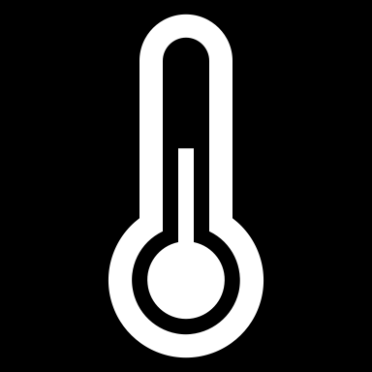
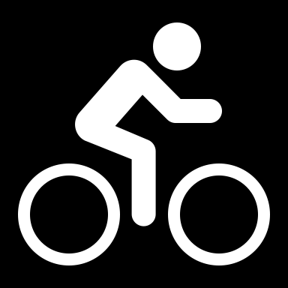
Regression
56 | 115
61 | 126
67 | 137
72 | 140
76 | 152
82 | 156
x y
Training
ŷ
116
128
137
146
155
1.5
f(x)
1
35
f(x)=35 + 1.5x
54 | 114
62 | 129
68 | 130
74 | 152
80 | 154
Validation
Notes:
This is an animated slide – use the notes below to talk to each animation build (clicks are indicated by numbers)
One of the most common machine learning technique is called regression. You use regression when you want to predict a numeric value; like a price, a sales total, or some other measure.
Let's look at an example and get an idea of how it works. There's a little mathematics involved, but don't worry – the basic idea is fairly straightforward!
In this example, we'll imagine a bicycle rental company that wants to predict the number of rentals on a given day based on weather conditions.
We'll start with some historical data about cycle rentals. For this simple example, we'll restrict this to just the temperature and number of rentals per day. In reality there would be more factors to consider. {A table of data showing daily temperatures and the number of rentals appears}
The number of rentals is the label we're going to predict, and we're going to use the daily temperature as a feature on which to base the prediction. Generally, we refer to the feature (or features) as X and the label as Y; and what we're going to do is to try to figure out a function that we can apply to X to get the value of Y. This function will be the basis for a model that we can use to predict Y for any given value of X. {X appears above the temperature column, and Y appears above the rentals column}
When we find a function, we'll want to validate it with some data for days where we already know the number of rentals so we can see how well it predicts; so we'll split the data into a subset that we'll use the train the model, and hold back a subset for validation. {The table is split into a training subset and a validation subset}
To find an appropriate function, let's plot the X and Y values so we can visualize the relationship between them. {A chart showing X values plotted against Y values from the training subset is displayed
Looking at the plot, you can see a trend in which higher temperatures tend to correlate with more rentals. In fact, we can fit a line between the plotted points that more or less describes this correlation and we can use this line to work out a calculation that produces Y from X. The ability to use a line like this to define a function for the X/Y relationship is technically called linear regression; which sounds complicated, but let's look at the basic principle of how it works and hopefully you'll find that it's actually fairly intuitive. {A diagonal line showing a trend where high X values tend to correlate to high Y values is added to the chart}
The point where the line intercepts the Y axis is around 35… {The point where the line intersects the Y axis is highlighted on the chart}
…and the slope of the line is such that for every 1 unit of X it goes along, it goes up around 1.5 units of Y… {The slope of the line is shown by an arrow going left for 1 unit and an arrow going up for 1.5 units}
…so the function that operates on X to find Y is 35 plus 1.5 times X. {The function "f(x) = 35 + 1.4x" is displayed}
Now we can test that function with the validation data that we held back. Here are the values we get from the function for the temperatures on those days – because this is a prediction of Y rather than the actual Y value, we write it with a little "hat" and call it Y-hat. {A column of values calculated by using the function is added alongside the actual Y values in the validation subset}
Let's plot the actual values from the validation data along with the line from which the predicted values were calculated. {The actual values from the validation subset are plotted on the chart alongside the line that represents the predictive function}
Now we can see how well the model predicts by measuring the difference between the predicted values and the actual values that we know to be true – this tells us the amount of error in the model. There are various ways to calculate this error value and generate common metrics that we can use to evaluate a regression model. {Arrows indicating the distance between each actual value and the prediction function line are added to the chart}
This is a simple example, just to describe the general concepts and process for training and evaluating a regression model. In a real-world scenario, the training algorithm would need to fit multiple features (X values) to a regression function; but the basic principles remain the same. You start with some data that contains features and labels, you use some of the data to train a regression model by using an algorithm that tries to determine a function for X that predicts Y; and then you evaluate the trained model using the validation data that you held back. If you're happy with the level of error in the model, you can then use it to infer unknown label values in new cases.

Slide 8
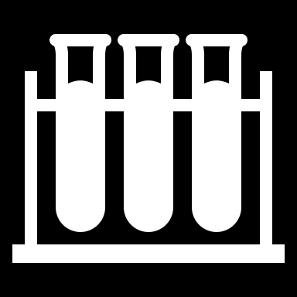
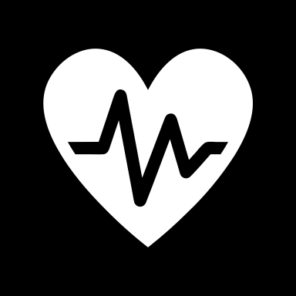
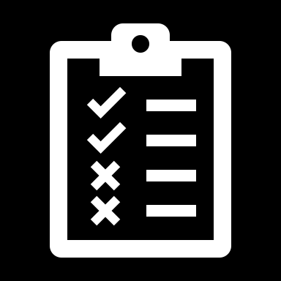
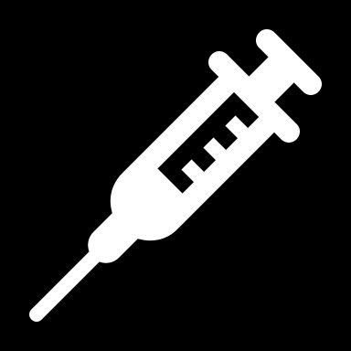
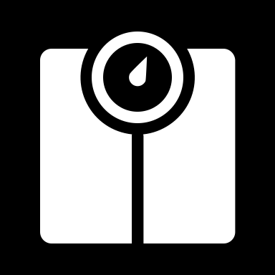
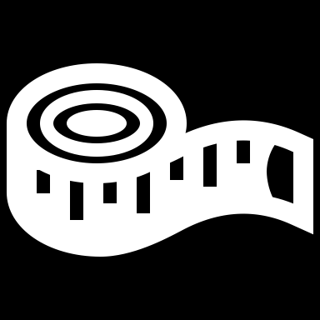


Classification
Actual
[4,2,3.2,10] | 0
[6,3,1.7,12] | 1
[5,2,3.5,11] | 0
[4,1,2.9,10] | 0
[7,4,2.1,11] | 1
1
0
126
1
1
21
1
[7,3,1.8,11]
[7,4,2.1,11]
x y
Predicted
True Positive
7
119
1
1
0
[6,3,1.7,12]
Training
[4,8,2.5,10]
False Positive
[4,1,3,1,11]
[5,2,3.5,11]
False Negative
P(1) | P(0) | ŷ
0.2 | 0.8 | 0
0.9 | 0.1 | 1
0.6 | 0.4 | 1
0.3 | 0.7 | 0
[3,1,2.8,10] | 0
[7,3,1.8,11] | 1
[4,8,2.5,10] | 0
[4,1,3,1,11] | 1
[4,2,3.2,10]
[3,1,2.8,10]
True Negative
[4,1,2.9,10]
Validation
Notes:
This is an animated slide – use the notes below to talk to each animation build (clicks are indicated by numbers)
Regression is a form of supervised machine learning – in other words it relies on us having some data with known label values that we can fit to a model, which can then be applied to new data for which we don’t have the label values. Now let's look at another type of supervised machine learning – classification.
Again, there's some mathematics involved – in particular, probability. Don’t worry too much about the details – just remember that probability is always a value between 0 and 1, where 1 means a definite, 100% certainty.
Just as with regression, we start with some data that includes features and known labels. In this case, the features are medical measurements that might be taken during a health checkup – such as weight, height, blood pressure, and so on. This time, the label isn't a numeric value but an indicator of whether the patient is diabetic (in which case the label has a value of 1) or not (in which case it is 0). The label indicates to which class the patient belongs – diabetic or non-diabetic. {A table of data appears. In the first column, the values are vectors (lists) of diagnostic measurements. The second column contains a 1 or a 0}
Once again, we split the data into subsets for training and validation. {The table is split into training and validation subsets}
Now, we'll take the training values and apply an algorithm that fits them to a function so that the Y value is between 0 and 1, like this. {A chart showing the feature vectors plotted against the label values is displayed
Since the value can be anywhere between 0 and 1, a threshold value is used to determine the cut-off point where the class is considered to be 0 or 1. In this case, all patients with features producing a value greater than 0.5 are diabetic, and those with values below that threshold are not. {A line is added to the chart at the 0.5 threshold – all points plotted above this represent diabetic patients, and all points below represent non-diabetic patients}
The function we've fitted to the data is an example of a logistic function. You can think of the value as representing the probability that the class is 1 (in other words, that the patient is diabetic). {A Sigmoidal (s-shaped) function graph is shown with a minimum value of 0 and a maximum of 1}
Having determined a function that fits our features, a model is produced and we can use the validation data we held back to test it. Here are the results of applying the logistic model to our validation features. {The validation data points are plotted on the chart alongside the predictive function}
The function returns the probability that the class is 1, or positive, as a value between 0 and 1; and since there are only two possible classes, and there's a 100% probability that the patient is one of them (they're either diabetic or not!), the probability that the class is 0, or negative, is also known (it's just 1 minus the probability that it's positive) The class with the highest probability is the predicted value for Y. {A table showing the probability values for each possible class calculated by the function, and consequent 1 or 0 class prediction, is shown alongside the validation subset}
Let's look at the first validation case. In this case, the predicted class label is 0 and the actual label is also 0, so the model got it right. It's a true negative. {A tick appears alongside the first prediction}
The second case results in a prediction of 1 for an actual value of 1, so again it's correct – this time it's a true positive. {A tick appears alongside the second prediction}
For the third case, the prediction is 1 but the actual label is 0, so the model got this one wrong – it’s a false positive. {A cross appears alongside the third prediction}
The fourth one is also wrong – this time, a false negative. {A cross appears alongside the fourth prediction}
To evaluate the model, we tabulate the prediction results in a format called a confusion matrix, like this. {A 2 by 2 matrix of actual labels of 1 and 0 crossed with predicted labels of 1 and 0 is displayed, and the plotted points move to the appropriate quadrant of the matrix based on their predicted and actual values}
In a real scenario, you'd use much more validation data than we have on the slide, so it might end up looking something like this. {The numbers in the matrix increase to show 126 true positives, 7 false positives, 119 true negatives, and 21 false negatives}
If we apply a heatmap to this, intensifying the cells in the matrix to reflect the values, you can easily see that the correct predictions in the true positive and true negative cells form a dark diagonal line from top left to bottom right – indicating that the model got more predictions right than wrong. {The quadrants in the matrix are shaded, with higher values darker than lower values – this reveals a diagonal pattern of high values for true positives and true negatives}
From the values in the confusion matrix, you can calculate multiple metrics that can be used to measure the performance of the model.

Slide 9
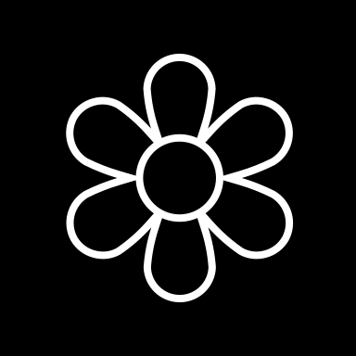


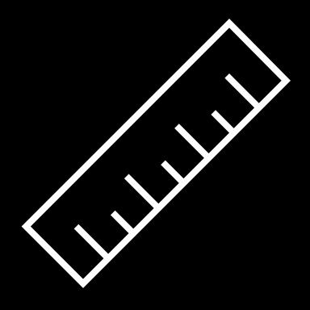




Clustering
 | 6 | 3
 | 5 | 3
 | 2 | 3
 | 1 | 3
 | 3 | 8
 | 4 | 8
Notes:
This is an animated slide – use the notes below to talk to each animation build (clicks are indicated by numbers)
Regression and Classification are both forms of supervised machine learning.
Now let's look at a form of unsupervised machine learning – clustering.
Suppose we collect some observations of flowers, noting the height and number of petals for each sample. What we want to do is group flowers that are similar together, but we have no known label that we can use to train a model. {A table of flower heights and petal counts is shown}
Instead, we think of the feature values that we have as being coordinates on which we can plot the sample data points – in this case we have two features, height and petals, so we can plot them on a 2-dimensional grid like this. {A grid is shown with flowers plotted for each height and petal count coordinate pair}
Now we need to decide how many clusters we want to group the observations into. This value is generally referred to as K, and we simply assign K points at random locations on our grid like this. In this case, we've used a K value of 3; so we'll end up with 3 clusters. {Three centroid points are plotted on the grid at random coordinates}
Each of the K points we've plotted will be a centroid for a cluster, so we assign the sample data points to its nearest centroid. {Three shaded cluster areas enclosing the flowers that are nearest to each randomly plotted centroid is added}
Now we move each centroids to the middle of the points in its cluster – based on the mean distance. {The centroid points are moved to the center of the flowers in their cluster}
Now that the centroids have moved, some sample points might be nearer to a different centroid from the one they're currently allocated to; so we reallocate the samples to their nearest centroid. {The cluster shapes are redrawn to reflect the flowers that are now closest to each centroid}
And then we just repeat the process until the clusters are stable, or we reach a pre-determined maximum number of iterations. In this case, the clusters soon stabilize as well-separated groups of related flowers. {The centroids are iteratively moved to the middle of their cluster and the clusters reallocated until a stable set of separated clusters is defined and the centroids are fixed in the middle of their flowers}
This clustering technique, which uses K centroids and moves them to the mean distance between their data points is known as K-Means clustering.

Slide 10
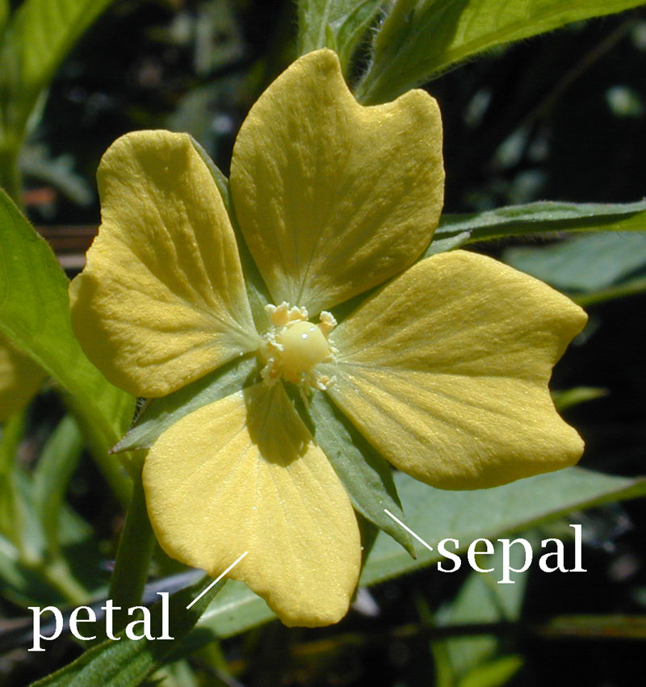
Example: Using K
Problem: how to identify different flower species given a set of features?
given the following fictitious data set.
Q1: how many species?
Q2: supervised or unsupervised?
Sample ID | Sepal length | Sepal width | Petal length | Petal width
1 | 6.1 | 3.2 | 1.7 | 0.4
2 | 5.9 | 2.9 | 1.4 | 0.3
3 | 2.7 | 1.2 | 4.3 | 1.6
4 | 3 | 1.6 | 5.9 | 2.0
5 | 2.9 | 1.5 | 3.0 | 3.5
6 | 2.4 | 1.1 | 2.9 | 3.2

Slide 11
Bias and variance

Slide 12
When we build a model, we are trying to create a model that is a perfect fit to the population
Typically there is error in the model and that error can be due to two broad categories:
Irreducible error
Reducible error
Bias and variance
Notes:
When we build a model, we are trying to create a model that is a perfect fit to the population (the complete set of data that exists in the world). At best, we usually have a sample
Typically there is error in the model and that error can be due to two broad categories:
Irreducible error
Reducible error
Irreducible error (inherent uncertainty) is, as the name suggests, the error that is inherent in the system that cannot (wait for it) be reduced
Examples might be the errors in recording equipment, the variations due to uncontrolled variables (air pressure, temperature) and so on
Reducible error splits into two:
Bias
Bias is simply defined as the inability of the model because of that there is some difference or error occurring between the model’s predicted value and the actual value. These differences between actual or expected values and the predicted values are known as error or bias error or error due to bias. Bias is a systematic error that occurs due to wrong assumptions in the machine learning process.
Variance
Variance is the measure of spread in data from its mean position. In machine learning variance is the amount by which the performance of a predictive model changes when it is trained on different subsets of the training data. More specifically, variance is the variability of the model that how much it is sensitive to another subset of the training dataset. i.e. how much it can adjust on the new subset of the training dataset.

Slide 13
Bias and variance
Low Variance
High Variance
Low Bias
High Bias
Notes:
You can think about these two like this, which is a very common way of expressing the difference
Underfitting (High bias/Low Variance)
happens when a model unable to capture the underlying pattern of the data. These models usually have high bias and low variance. It happens when we have very less amount of data to build an accurate model or when we try to build a linear model with a nonlinear data. Also, these kind of models are very simple to capture the complex patterns in data like Linear and logistic regression.
Overfitting (Low Bias/High Variance)
happens when our model captures the noise along with the underlying pattern in data. It happens when we train our model a lot over noisy dataset. These models have low bias and high variance. These models are very complex like Decision trees which are prone to overfitting.

Slide 14
Bias
Low Bias
High Bias
Notes:
Bias is the overall inaccuracy of the model. It is the result of erroneous assumptions that occurred during learning. We try to reduce bias because it leads to a situation where the algorithm that is building the model fails to capture relationships between the features and the ideal output

Slide 15
Variance
Low Variance
High Variance
Notes:
Variance is the error that results from small and non-significant fluctuations in the training data that are captured (when they should not be) in the model. In other words, it is when the model is fitted to the training data so precisely that it is capturing the noise therein. This leads to overfitting
if the test data is a very good representation of the population, then the variance is also low
Variance is the error we get as a result of sensitivity to small, unrepresentative, fluctuations in the training data set. Variance describes the case where random fluctuations in the test data become part of the model
Variance is about how well the model fits the population data. For example, suppose that you build a model from a set of test data. Then you obtain another set of test data and regenerate the model. You get very nearly the same model. You find another set of test data and repeat. Again you get a very similar model. Eventually you can say that the variance in this case is low

Slide 16
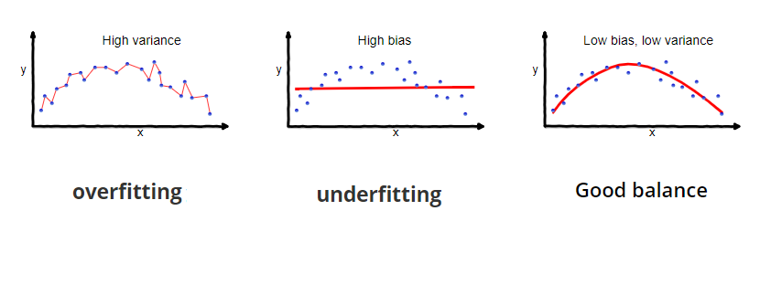

Slide 17
Bias and variance
Error
Error
Optimal
Variance
Bias²
Model complexity
Notes:
Why is Bias Variance Tradeoff?
If our model is too simple and has very few parameters then it may have high bias and low variance.
On the other hand if our model has large number of parameters then it’s going to have high variance and low bias. So we need to find the right/good balance without overfitting and underfitting the data.
This tradeoff in complexity is why there is a tradeoff between bias and variance. An algorithm can’t be more complex and less complex at the same time.
Total Error
To build a good model, we need to find a good balance between bias and variance such that it minimizes the total error.
Summary
As a general rule, as the complexity of the model increases, the bias decreases, however the variance increases
There is a sweet spot

Slide 18
Algorithm Selection

Slide 19
Types of Algorithms
Linear Regression
Logistic Regression
K-means
KNN
Support Vector Machines
Notes:
KNN Straight away, the two (Kmeans) seek to accomplish different goals. K-nearest neighbors is a classification algorithm, which is a subset of supervised learning. K-means is a clustering algorithm, which is a subset of unsupervised learning. If we have a dataset of football players, their positions, and their measurements, and we want to assign positions to football players in a new dataset where we have measurements but no positions, we might use K-nearest neighbors. On the other hand, if we have a dataset of football players who need to be grouped into K distinct groups based off of similarity, we might use K-means. Correspondingly, the K in each case also mean different things! In K-nearest neighbors, the K represents the number of neighbors who have a vote in determining a new player’s position.
Support Vector Machines SVM uses hyperplanes (straight things) to separate two differently labeled points.
Sometimes the points can’t be separated by straight things, so it needs to map them to a higher dimensional space (using kernels!) where they can be split by straight things (hyperplanes!). T
his looks like a curvy line on the original space, even though it is really a straight thing in a much higher dimensional space!

Slide 20
Types of Algorithms
Random Forest
Neural networks
Notes:
Random Forest (Ensemble of decision trees)
Let’s say we want to know when to invest in Procter & Gamble so we have three choices buy, sell and hold based on several data from the past month like open price, close price, change in the price and volume Imagine you have a lot of entries, 900 points of data. We want to build a decision tree to decide the best strategy, for example, if there is a change in the price of the stock more than ten percent higher than the day before with high volume we buy this stock. But we don’t know which features to use, we have a lot. So we take a random set of measures and a random sample of our training set and we build a decision tree.
Then we do the same many times using a different random set of measurements and a random sample of data each time.
At the end we have many decision trees, we use each of them to forecast the price and then decide the final prediction based on a simple majority.
Neural networks A neural network is a form of artificial intelligence. The basic idea behind a neural network is to simulate lots of densely interconnected brain cells inside a computer so it can get it to learn things, recognize patterns, and make decisions in a human-like way. The amazing thing about a neural network is that it doesn’t have to program it to learn explicitly: it learns all by itself, just like a brain! On one hand of the neural network, there are the inputs. This could be a picture, data from a drone, or the state of a Go board. On the other hand, there are the outputs of what the neural network wants to do. In between, there are nodes and connections between those. The strength of the connections determines what output is called for based on the inputs.
Deep learning is a “deep” neural network that includes many layers of neurons and a huge volume of data. This advanced type of machine learning can solve complex problems and is responsible for Artificial Intelligence breakthroughs such as natural language processing (NLP), personal digital assistants, and self-driving cars etc.

Slide 21
Accuracy
Training time
Linearity
Number of parameters
Number of features
Criteria
Notes:
Type of problem: It is obvious that algorithms have been designed to solve specific problems. So, it is important to know what type of problem we are dealing with and what kind of algorithm works best for each type of problem.
Size of training set: This factor is a big player in our choice of algorithm. For a small training set, high bias/low variance classifiers (e.g., Naive Bayes) have an advantage over low bias/high variance classifiers (e.g., kNN), since the latter will overfit. But low bias/high variance classifiers start to win out as training set grows (they have lower asymptotic error), since high bias classifiers aren’t powerful enough to provide accurate models.
Accuracy
Accuracy in machine learning measures the effectiveness of a model as the proportion of true results to total cases.
Getting the most accurate answer possible isn’t always necessary.
Sometimes an approximation is adequate, depending on what you want to use it for.
If that is the case, you may be able to cut your processing time dramatically by sticking with more approximate methods.
Approximate methods also naturally tend to avoid overfitting.
Training time
In supervised learning, training means using historical data to build a machine learning model that minimizes errors.
The number of minutes or hours necessary to train a model varies a great deal between algorithms.
Training time is often closely tied to accuracy; one typically accompanies the other.
In addition, some algorithms are more sensitive to the number of data points than others.
You might choose a specific algorithm because you have a time limitation, especially when the data set is large.
Linearity
Linearity in statistics and machine learning means that there is a linear relationship between a variable and a constant in your dataset. For example, linear classification algorithms assume that classes can be separated by a straight line (or its higher-dimensional analog).
Lots of machine learning algorithms make use of linearity.
Linear regression algorithms assume that data trends follow a straight line.
This assumption isn't bad for some problems, but for others it reduces accuracy.
Despite their drawbacks, linear algorithms are popular as a first strategy.
They tend to be algorithmically simple and fast to train.
Number of parameters
Parameters are the knobs a data scientist gets to turn when setting up an algorithm.
They are numbers that affect the algorithm’s behavior, such as error tolerance or number of iterations, or options between variants of how the algorithm behaves.
The training time and accuracy of the algorithm can sometimes be sensitive to getting just the right settings.
Typically, algorithms with large numbers of parameters require the most trial and error to find a good combination.
Number of features
In machine learning, a feature is a quantifiable variable of the phenomenon you are trying to analyze.
For certain types of data, the number of features can be very large compared to the number of data points.
This is often the case with genetics or textual data.
A large number of features can bog down some learning algorithms, making training time unfeasibly long.
Support vector machines are particularly well suited to scenarios with a high number of features.
For this reason, they have been used in many applications from information retrieval to text and image classification.
Support vector machines can be used for both classification and regression tasks.
Feature selection refers to the process of applying statistical tests to inputs, given a specified output. The goal is to determine which columns are more predictive of the output.

Slide 22
Classification Family
Algorithm | Accuracy | Training Time | Linearity | Parameters
logistic regression | Good | Fast | Yes | 4
Decision forest | Excellent | Moderate | No | 5
Boosted decision tree | Excellent | Moderate | No | 6
neural network | Good | Moderate | No | 8
averaged perceptron | Good | Moderate | Yes | 4

Slide 23
Classification Family
Algorithm | Accuracy | Training Time | Linearity | Parameters
support vector machine | Good | Fast | Yes | 5
Multiclass logistic regression | Good | Fast | Yes | 4
Multiclass decision forest | Excellent | Moderate | No | 5
Multiclass boosted decision tree | Excellent | Moderate | No | 6
Multiclass neural network | Good | Moderate | No | 8

Slide 24
Regression Family
Algorithm | Accuracy | Training Time | Linearity | Parameters
Linear regression | Good | Fast | Yes | 4
Decision forest regression | Excellent | Moderate | No | 5
Boosted decision tree regression | Excellent | Moderate | No | 6
Neural network regression | Good | Moderate | No | 8

Slide 25
Clustering Family
Algorithm | Accuracy | Training Time | Linearity | Parameters
K-means clustering | Excellent | Moderate | Yes | 8

Slide 26
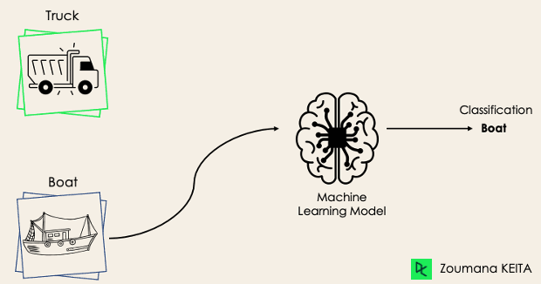
Binary Classification
Notes:
n a binary classification task, the goal is to classify the input data into two mutually exclusive categories. The training data in such a situation is labeled in a binary format: true and false; positive and negative; O and 1; spam and not spam, etc. depending on the problem being tackled. For instance, we might want to detect whether a given image is a truck or a boat.
Logistic Regression and Support Vector Machines algorithms are natively designed for binary classifications. However, other algorithms such as K-Nearest Neighbors and Decision Trees can also be used for binary classification.

Slide 27
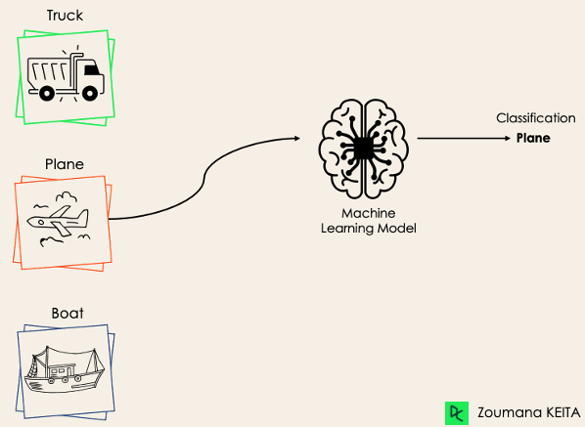
Multi-Class Classification
Notes:
The multi-class classification, on the other hand, has at least two mutually exclusive class labels, where the goal is to predict to which class a given input example belongs to. In the following case, the model correctly classified the image to be a plane.
Most of the binary classification algorithms can be also used for multi-class classification. These algorithms include but are not limited to:
Random Forest
Naive Bayes
K-Nearest Neighbors
Gradient Boosting
SVM
Logistic Regression.

Slide 28
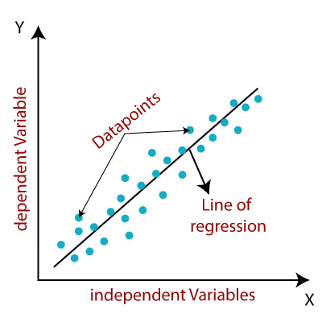
Linear Regression – Regression Family
Predictions for continuous/real or numeric variables such as sales, salary, age, product price, etc.
Provides a sloped straight line representing the relationship between the variables.
Linear relationship between the features and target.
Notes:
Linear regression is one of the easiest and most popular Machine Learning algorithms. It is a statistical method that is used for predictive analysis. Linear regression makes predictions for continuous/real or numeric variables such as sales, salary, age, product price, etc.
Linear regression algorithm shows a linear relationship between a dependent (y) and one or more independent (y) variables, hence called as linear regression. Since linear regression shows the linear relationship, which means it finds how the value of the dependent variable is changing according to the value of the independent variable.
The linear regression model provides a sloped straight line representing the relationship between the variables.

Slide 29
Linear Regression
56 | 115
61 | 126
67 | 137
72 | 140
76 | 152
82 | 156
x y
Training
ŷ
116
128
137
146
155
1.5
f(x)
1
35
f(x)=35 + 1.5x
54 | 114
62 | 129
68 | 130
74 | 152
80 | 154
Validation
Notes:
This is an animated slide – use the notes below to talk to each animation build (clicks are indicated by numbers)
One of the most common machine learning technique is called regression. You use regression when you want to predict a numeric value; like a price, a sales total, or some other measure.
Let's look at an example and get an idea of how it works. There's a little mathematics involved, but don't worry – the basic idea is fairly straightforward!
In this example, we'll imagine a bicycle rental company that wants to predict the number of rentals on a given day based on weather conditions.
We'll start with some historical data about cycle rentals. For this simple example, we'll restrict this to just the temperature and number of rentals per day. In reality there would be more factors to consider. {A table of data showing daily temperatures and the number of rentals appears}
The number of rentals is the label we're going to predict, and we're going to use the daily temperature as a feature on which to base the prediction. Generally, we refer to the feature (or features) as X and the label as Y; and what we're going to do is to try to figure out a function that we can apply to X to get the value of Y. This function will be the basis for a model that we can use to predict Y for any given value of X. {X appears above the temperature column, and Y appears above the rentals column}
When we find a function, we'll want to validate it with some data for days where we already know the number of rentals so we can see how well it predicts; so we'll split the data into a subset that we'll use the train the model, and hold back a subset for validation. {The table is split into a training subset and a validation subset}
To find an appropriate function, let's plot the X and Y values so we can visualize the relationship between them. {A chart showing X values plotted against Y values from the training subset is displayed
Looking at the plot, you can see a trend in which higher temperatures tend to correlate with more rentals. In fact, we can fit a line between the plotted points that more or less describes this correlation and we can use this line to work out a calculation that produces Y from X. The ability to use a line like this to define a function for the X/Y relationship is technically called linear regression; which sounds complicated, but let's look at the basic principle of how it works and hopefully you'll find that it's actually fairly intuitive. {A diagonal line showing a trend where high X values tend to correlate to high Y values is added to the chart}
The point where the line intercepts the Y axis is around 35… {The point where the line intersects the Y axis is highlighted on the chart}
…and the slope of the line is such that for every 1 unit of X it goes along, it goes up around 1.5 units of Y… {The slope of the line is shown by an arrow going left for 1 unit and an arrow going up for 1.5 units}
…so the function that operates on X to find Y is 35 plus 1.5 times X. {The function "f(x) = 35 + 1.4x" is displayed}
Now we can test that function with the validation data that we held back. Here are the values we get from the function for the temperatures on those days – because this is a prediction of Y rather than the actual Y value, we write it with a little "hat" and call it Y-hat. {A column of values calculated by using the function is added alongside the actual Y values in the validation subset}
Let's plot the actual values from the validation data along with the line from which the predicted values were calculated. {The actual values from the validation subset are plotted on the chart alongside the line that represents the predictive function}
Now we can see how well the model predicts by measuring the difference between the predicted values and the actual values that we know to be true – this tells us the amount of error in the model. There are various ways to calculate this error value and generate common metrics that we can use to evaluate a regression model. {Arrows indicating the distance between each actual value and the prediction function line are added to the chart}
This is a simple example, just to describe the general concepts and process for training and evaluating a regression model. In a real-world scenario, the training algorithm would need to fit multiple features (X values) to a regression function; but the basic principles remain the same. You start with some data that contains features and labels, you use some of the data to train a regression model by using an algorithm that tries to determine a function for X that predicts Y; and then you evaluate the trained model using the validation data that you held back. If you're happy with the level of error in the model, you can then use it to infer unknown label values in new cases.

Slide 30

Logistic Regression – Classification Family
It gives the probabilistic values which lie between 0 and 1.
The curve from the logistic function indicates the likelihood of something such as whether the cells are cancerous, a mouse is obese based on its weight, etc.
Uses the concept of predictive modeling as regression; hence called logistic regression, but is used to classify samples; Therefore, it falls under the classification algorithm.
Notes:
Logistic regression is a supervised machine learning algorithm mainly used for classification tasks where the goal is to predict the probability that an instance of belonging to a given class. It is used for classification algorithms its name is logistic regression. it’s referred to as regression because it takes the output of the linear regression function as input and uses a sigmoid function to estimate the probability for the given class. The difference between linear regression and logistic regression is that linear regression output is the continuous value that can be anything while logistic regression predicts the probability that an instance belongs to a given class or not.
It can be either Yes or No, 0 or 1, true or False, etc. but instead of giving the exact value as 0 and 1, it gives the probabilistic values which lie between 0 and 1. Logistic Regression is much similar to the Linear Regression except that how they are used. Linear Regression is used for solving Regression problems, whereas Logistic regression is used for solving the classification problems.
n Logistic regression, instead of fitting a regression line, we fit an “S” shaped logistic function, which predicts two maximum values (0 or 1). The curve from the logistic function indicates the likelihood of something such as whether the cells are cancerous or not, a mouse is obese or not based on its weight, etc.
Logistic Function (Sigmoid Function):
The sigmoid function is a mathematical function used to map the predicted values to probabilities.
It maps any real value into another value within a range of 0 and 1.
The value of the logistic regression must be between 0 and 1, which cannot go beyond this limit, so it forms a curve like the "S" form. The S-form curve is called the Sigmoid function or the logistic function.
In logistic regression, we use the concept of the threshold value, which defines the probability of either 0 or 1. Such as values above the threshold value tends to 1, and a value below the threshold values tends to 0.
Assumptions for Logistic Regression:
The dependent variable must be categorical in nature.
The independent variable should not have multi-collinearity.

Slide 31
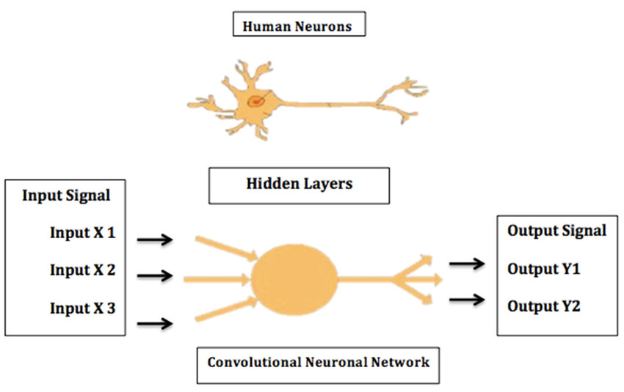
Neural Network
Notes:
The term "Artificial Neural Network" is derived from Biological neural networks that develop the structure of a human brain. Similar to the human brain that has neurons interconnected to one another, artificial neural networks also have neurons that are interconnected to one another in various layers of the networks. These neurons are known as nodes.
Biological Neural Network Artificial Neural Network
Dendrites Inputs
Cell nucleus Nodes
Synapse Weights
Axon Output
Input Layer:
As the name suggests, it accepts inputs in several different formats provided by the programmer.
Hidden Layer:
The hidden layer presents in-between input and output layers. It performs all the calculations to find hidden features and patterns.
Output Layer:
The input goes through a series of transformations using the hidden layer, which finally results in output that is conveyed using this layer.
The artificial neural network takes input and computes the weighted sum of the inputs and includes a bias. This computation is represented in the form of a transfer function.
ADVANTAGES
Parallel processing capability:
Artificial neural networks have a numerical value that can perform more than one task simultaneously.
Storing data on the entire network:
Data that is used in traditional programming is stored on the whole network, not on a database. The disappearance of a couple of pieces of data in one place doesn't prevent the network from working.
Capability to work with incomplete knowledge:
After ANN training, the information may produce output even with inadequate data. The loss of performance here relies upon the significance of missing data.
Having a memory distribution:
For ANN is to be able to adapt, it is important to determine the examples and to encourage the network according to the desired output by demonstrating these examples to the network. The succession of the network is directly proportional to the chosen instances, and if the event can't appear to the network in all its aspects, it can produce false output.
Having fault tolerance:

Slide 32
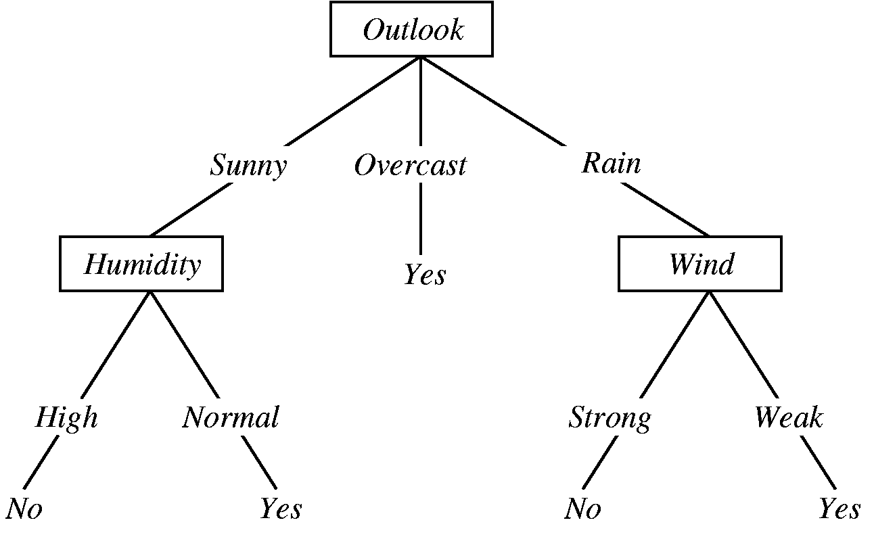
Decision forest
Notes:
A decision forest is a generic term to describe models made of multiple decision trees. The prediction of a decision forest is the aggregation of the predictions of its decision trees. The implementation of this aggregation depends on the algorithm used to train the decision forest. For example, in a multi-class classification random forest (a type of decision forest), each tree votes for a single class, and the random forest prediction is the most represented class. In a binary classification gradient boosted Tree (GBT) (another type of decision forest), each tree outputs a logit (a floating point value), and the gradient boosted tree prediction is the sum of those values followed by an activation function (e.g. sigmoid).
Random forest is a supervised learning algorithm. The “forest” it builds is an ensemble of decision trees, usually trained with the bagging method. The general idea of the bagging method is that a combination of learning models increases the overall result.
One big advantage of random forest is that it can be used for both classification and regression problems, which form the majority of current machine learning systems.
Let’s look at random forest in classification, since classification is sometimes considered the building block of machine learning.

Slide 33
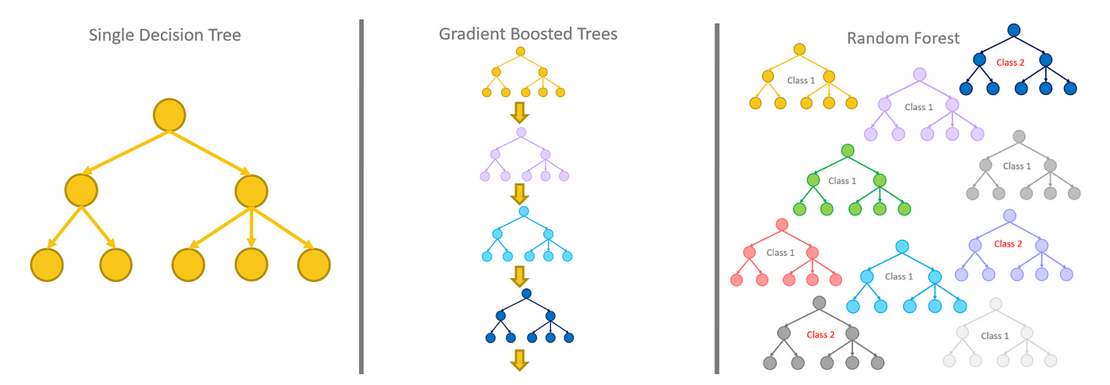
Random forests use a method called bagging
Bagging simply means combining in parallel.

Slide 34
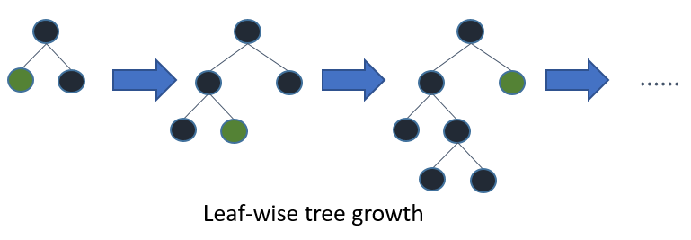
Gradient Boosted Trees
The goal is to train multiple trees one stage at a time. In each, we construct a single tree to correct the errors of the previously fitted ones.
Gradient boosting trees can be more accurate than random forests.
Notes:
The main idea behind this algorithm is to build models sequentially and these subsequent models try to reduce the errors of the previous model.
Boosting : Training a bunch of models sequentially. Each model learns from the mistakes of the previous model.
Boosting works on the principle of improving mistakes of the previous learner through the next learner. In boosting, weak learner are used which perform only slightly better than a random chance. Boosting focuses on sequentially adding up these weak learners and filtering out the observations that a learner gets correct at every step. Basically the stress is on developing new weak learners to handle the remaining difficult observations at each step.
All the trees are conncted in series and each tree tries to minimise the error of the previous tree. Due to this sequential connection, boosting algorithms are usually slow to learn, but also highly accurate. In statistical learning, models that learn slowly perform better.

Slide 35
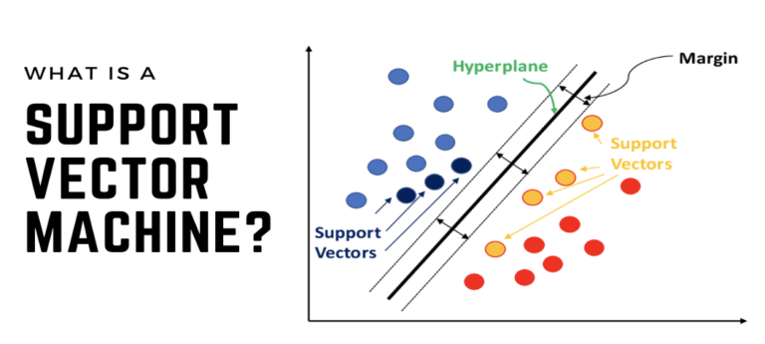
Notes:
Support Vector Machine (SVM) is a powerful machine learning algorithm used for linear or nonlinear classification, regression, and even outlier detection tasks. SVMs can be used for a variety of tasks, such as text classification, image classification, spam detection, handwriting identification, gene expression analysis, face detection, and anomaly detection. SVMs are adaptable and efficient in a variety of applications because they can manage high-dimensional data and nonlinear relationships.
How does SVM work?
One reasonable choice as the best hyperplane is the one that represents the largest separation or margin between the two classes.
So we choose the hyperplane whose distance from it to the nearest data point on each side is maximized. If such a hyperplane exists it is known as the maximum-margin hyperplane/hard margin. So from the above figure, we choose L2.

Slide 36
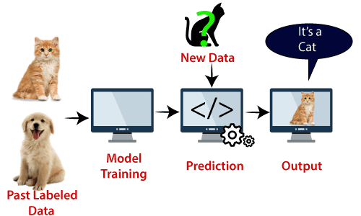
Support Vector Machine
SVM algorithm can be used for Face detection, image classification, text categorization, etc.
Notes:
Support Vector Machine (SVM) is a supervised machine learning algorithm used for both classification and regression. Though we say regression problems as well it’s best suited for classification. The main objective of the SVM algorithm is to find the optimal hyperplane in an N-dimensional space that can separate the data points in different classes in the feature space.
How does SVM work?
One reasonable choice as the best hyperplane is the one that represents the largest separation or margin between the two classes.
So we choose the hyperplane whose distance from it to the nearest data point on each side is maximized. If such a hyperplane exists it is known as the maximum-margin hyperplane/hard margin. So from the above figure, we choose L2.

Slide 37
K-Means Clustering
 | 6 | 3
 | 5 | 3
 | 2 | 3
 | 1 | 3
 | 3 | 8
 | 4 | 8
Notes:
This is an animated slide – use the notes below to talk to each animation build (clicks are indicated by numbers)
Regression and Classification are both forms of supervised machine learning.
Now let's look at a form of unsupervised machine learning – clustering.
Suppose we collect some observations of flowers, noting the height and number of petals for each sample. What we want to do is group flowers that are similar together, but we have no known label that we can use to train a model. {A table of flower heights and petal counts is shown}
Instead, we think of the feature values that we have as being coordinates on which we can plot the sample data points – in this case we have two features, height and petals, so we can plot them on a 2-dimensional grid like this. {A grid is shown with flowers plotted for each height and petal count coordinate pair}
Now we need to decide how many clusters we want to group the observations into. This value is generally referred to as K, and we simply assign K points at random locations on our grid like this. In this case, we've used a K value of 3; so we'll end up with 3 clusters. {Three centroid points are plotted on the grid at random coordinates}
Each of the K points we've plotted will be a centroid for a cluster, so we assign the sample data points to its nearest centroid. {Three shaded cluster areas enclosing the flowers that are nearest to each randomly plotted centroid is added}
Now we move each centroids to the middle of the points in its cluster – based on the mean distance. {The centroid points are moved to the center of the flowers in their cluster}
Now that the centroids have moved, some sample points might be nearer to a different centroid from the one they're currently allocated to; so we reallocate the samples to their nearest centroid. {The cluster shapes are redrawn to reflect the flowers that are now closest to each centroid}
And then we just repeat the process until the clusters are stable, or we reach a pre-determined maximum number of iterations. In this case, the clusters soon stabilize as well-separated groups of related flowers. {The centroids are iteratively moved to the middle of their cluster and the clusters reallocated until a stable set of separated clusters is defined and the centroids are fixed in the middle of their flowers}
This clustering technique, which uses K centroids and moves them to the mean distance between their data points is known as K-Means clustering.

